Slide 1
Welcome Concern’s Experience in Sustainable Development in the Haor Region - Zakir Ahmed Khan Head of Urban Program, Concern worldwide Date: 18 March, 2019

Slide 2
Presentation Outline: a. Concern’s presence in Haor b. Few of the Key Learnings from recent dev. programs c. Major challenges and recommendation

Slide 3
a. Concern’s presence in Haor

Slide 4
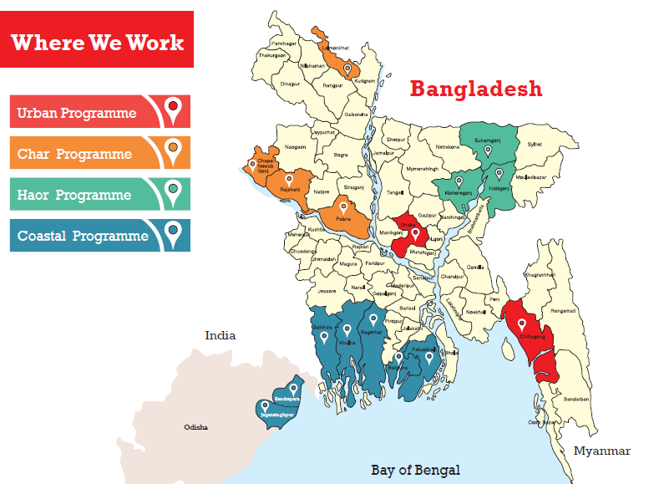
1988: Began with a flood response
1990 – implemented 12 integrated Livelihood dev. Graduation and Sectoral programs
Benefitted more than 1.0 m population, directly

Slide 5
Three dimensions Extreme poverty:
Concern’s Approach of Programming
Contextual Analysis
Programs aligned with national plans & priorities
Poverty dimensions | Level of interventions
Asset and Income | Micro Meso Macro
Inequality (causes, maintainers and obstacles)
Risk & Vulnerability (causes, maintainers and obstacles)
Integrated
Program for addressing extreme poverty

Slide 6
b. Key Learning from recent dev. programs (HISAL, ESEP, GEP-EBF etc.)

Slide 7
Concern’s Pathways to Sustainable Impact
Achieving sustainable Impacts
Continued business expansion, productivity; increased asset, sustained income and savings
Year-4
Increased access to finance, markets & institutions
Business expansion and diversification
Year-3
Extreme Poverty Threshold
Business operation cycle-2, market linkages, value chains
SHGs continues ROSBIs, re-invest savings; CBOs at in/formal power structures to bargain, arrange loans etc.
( C) Advocacy for enabling environment; access to gov. support and services
(a) Economic Empowerment
Input support, business operation, input materials, hand-holding supports
Year-2
CBOs with women leadership access to SSNs, Agriculture, Livestock, fisheries etc.
(b) Social Empowerment
Skills transfer on tested technologies, agriculture, business plan, vision
setting etc.
Formation of CBOs/apex body where applicable
Formation of SHGs, Group dynamics, savings habit/ROSBI etc.
Year-1
Ben. Selection, mobilization, motivation
Extreme Poverty

Slide 8
Proven interventions - Learnings from Recent Programs
Interventions
Holistic development plan for individual BHHs
Business approach > plans for expansion and diversification
Simplified, paperless savings & investment management mechanisms
Haor friendly, climate adaptive interventions e.g. tested cropping patterns, early maturing varieties etc.
Demand driven production, market linkage, value chains
Empowering groups > access to govt. services/social capital
Prevention of income erosion
Financial inclusion
Micro Level
Meso Levels
Engagement/advocacy with LEBs govt. departments at UZ, district levels
Macro
Advocacy at national level for policy influence working with APPG, HAP etc.

Slide 9
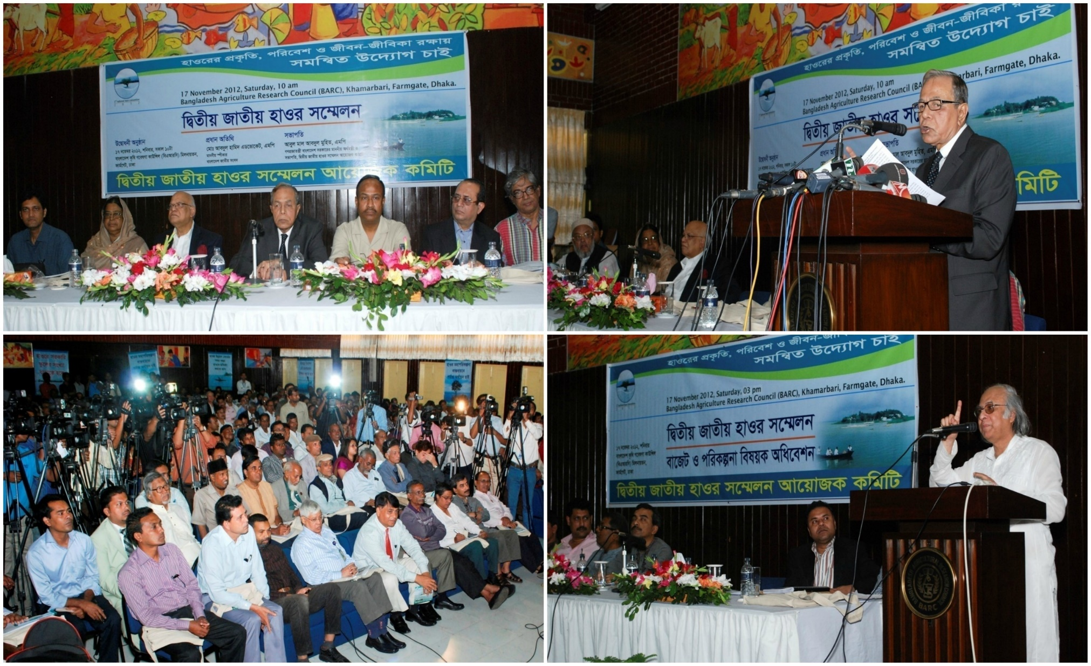
Advocacy at National Level
2nd National Haor Convention 2012
Hon. Speaker, Minister of Finance and other Policy Makers agree on implementing Haor Master Plan

Slide 10
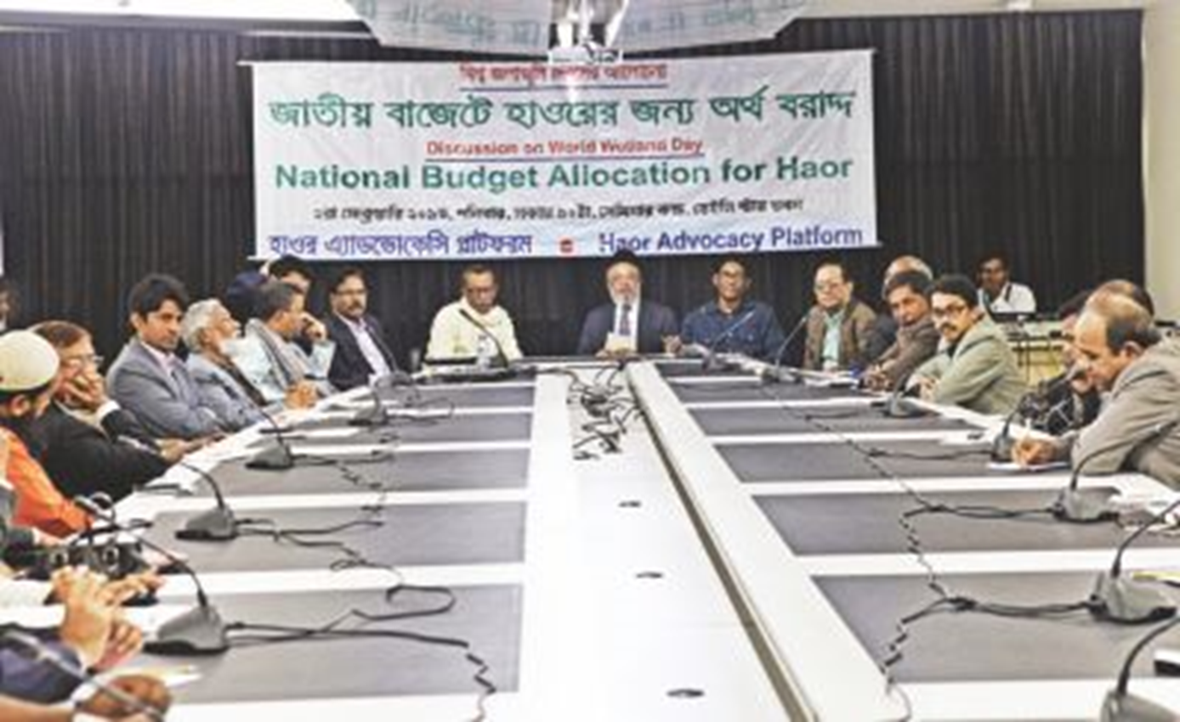
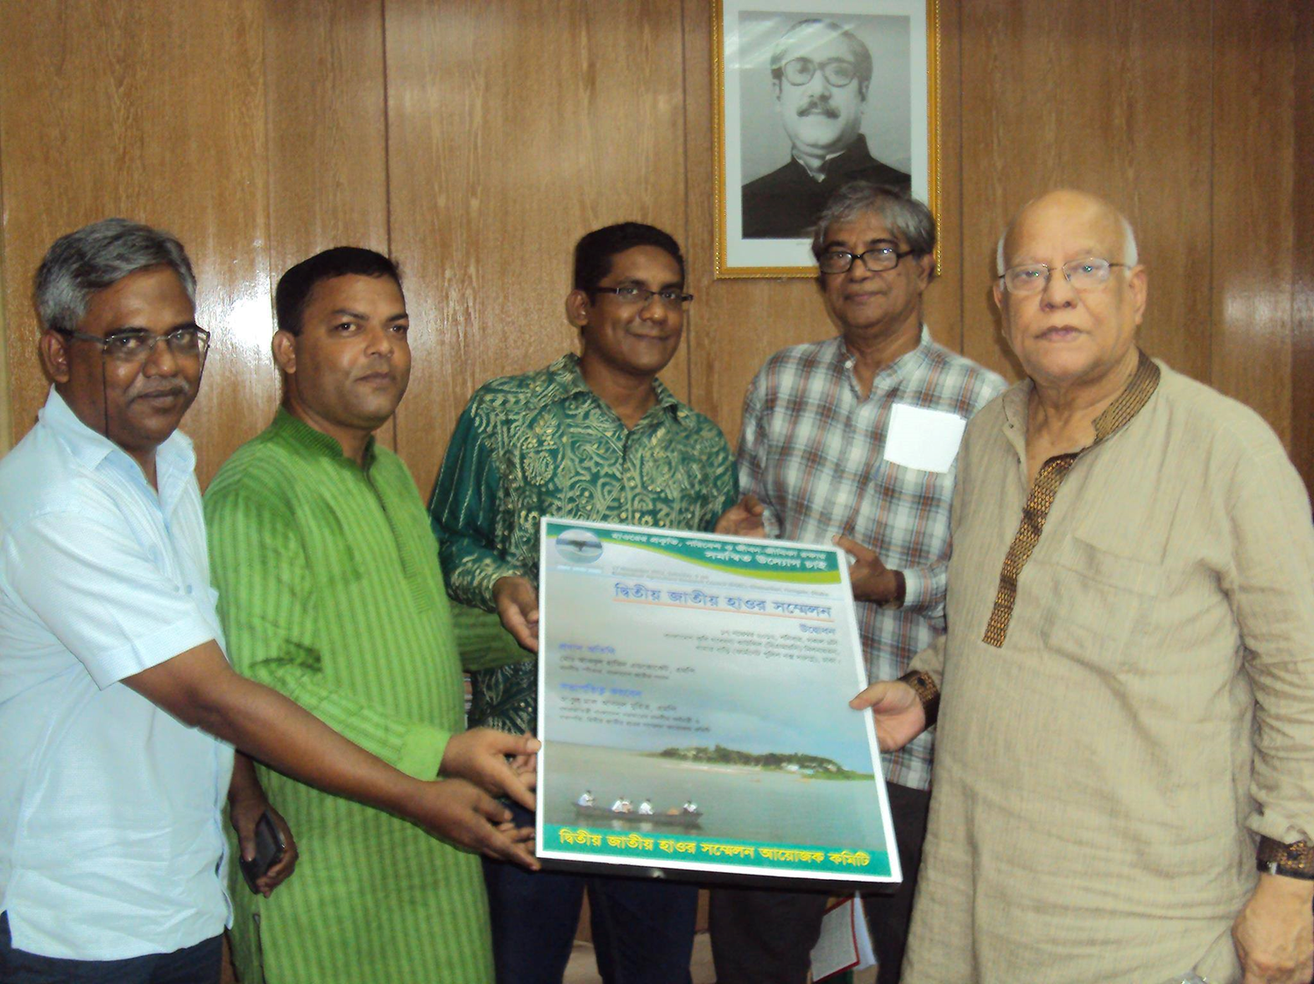
Advocacy at National level
Policy Dialogue on Budget Allocation for Haor
Lobby Meetings

Slide 11
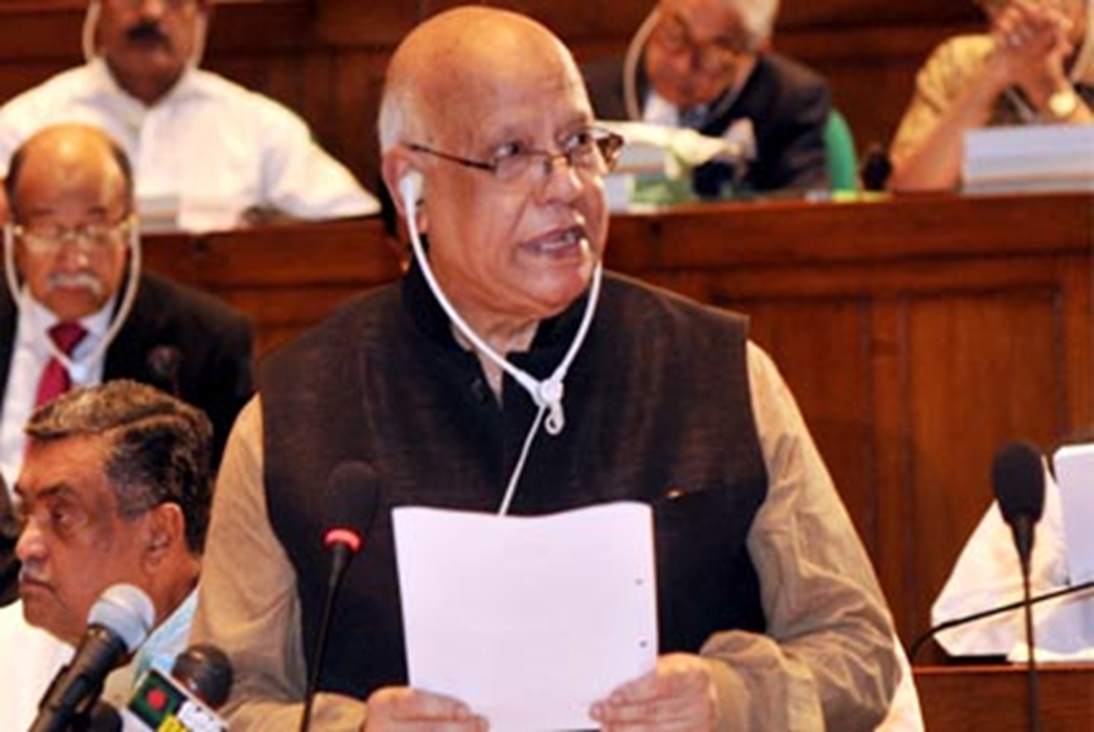
Advocacy at National Level
Special budget for Haor Continually Allocated with 50 Crore from 2013. In FY 2017-2018, 200 crore allocated for Haor and Char

Slide 12
Advocacy at National Level
All Party Parliamentary Group (APPG) on Haor Livelihood established at the National Parliament on 11 October, 2012
APPG on Haor work to bring Haor issues in policy makers attention

Slide 13
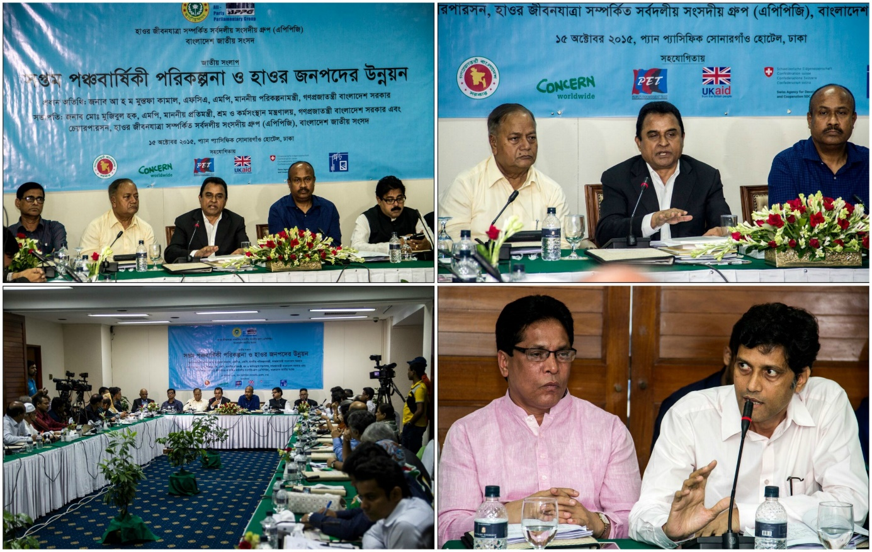
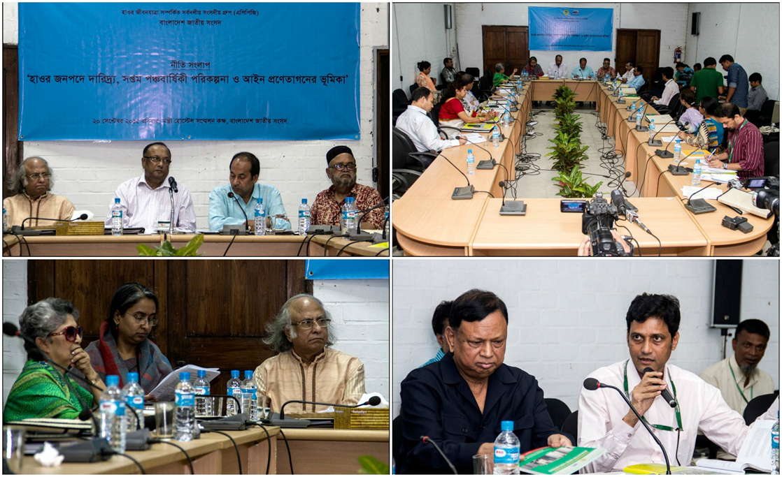
Advocacy at national level: Reflecting Haor in 7th Five Year Plan
Policy maker’s workshop on Haor poverty and 7th 5YP, 2015
National dialogue on 7th 5YP and Haor development, 2015

Slide 14
Key Challenges and recommendations…
Key Challenges and thought for the future …
Increased degradation in the bio-diversity and echo-systems due to adverse consequence of climate change
Intrusion of sand from hundreds of unplanned mining in Meghalaya is leaving thousands of hectors of lands barren and filling up the Haor basin
Untimely maintenance of embankments by relevant authorities
GO-NGO coordination
.

Slide 15
Recommendations..
Formulation of a localized strategy for achieving SDG targets with particular attention to SDG 14 and 15, engaging relevant CSOs, Researchers, Think tanks and Policy Makers.
Further empowerment of the Dept. of Haor and Wetland Dev.
Effective implementation of Haor Master plan in phases.
Continued advocacy at national and regional level to influence policy makers.
.

Slide 16
Thank You

